Slide 1
Survey on the Educational Expenditure of Public and Private University Students
A Study by Mahmud Kabir Department of Economics University of Barishal

Slide 2

Introduction
Key Points
Growth of private universities since 1992 in Bangladesh.
Concerns over quality due to regulatory inefficiencies.
Rising costs in private universities vs. subsidized costs in public universities.
Measure quality using student satisfaction.

Slide 3
Methodology
Survey Approach:
Mixed-method: Online surveys & in-person interviews.
Sample size: 100 students (34 private, 66 public).
Inclusion: Students across disciplines and age groups.

Slide 4
Key Findings - Tuition Fees
Private
Public
High fees, financial burden (70%).
Minimal burden (10%).

Slide 5
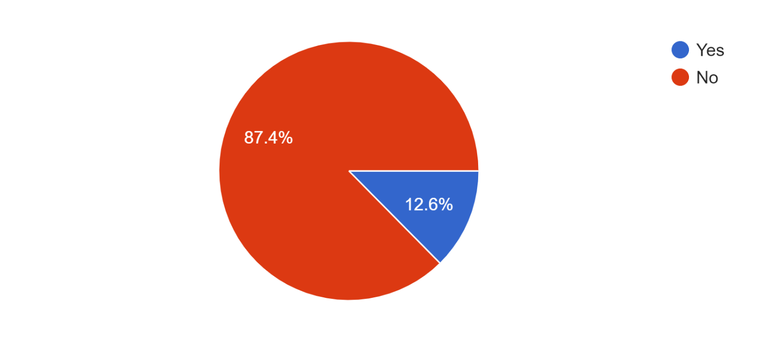
Key Findings - Scholarships & Financial Aid
Only 12.6% of students receive scholarships.
87.4% lack financial aid.

Slide 6
Key Findings - Housing/Accommodation
Expense Range:
37%: 1000-2000 BDT.
30%: 2000-3000 BDT.
18%: 3000-4000 BDT.
14%: Above 4000 BDT.

Slide 7
Public vs. Private Universities
Comparison:
60% believe private universities offer better resources.
30% disagree, 14% neutral.

Slide 8
Conclusion
Financial burden is a key concern across universities.
Scholarships and financial aid need enhancement.
Collaborationis needed to ensure affordable, quality education.

